Slide 1





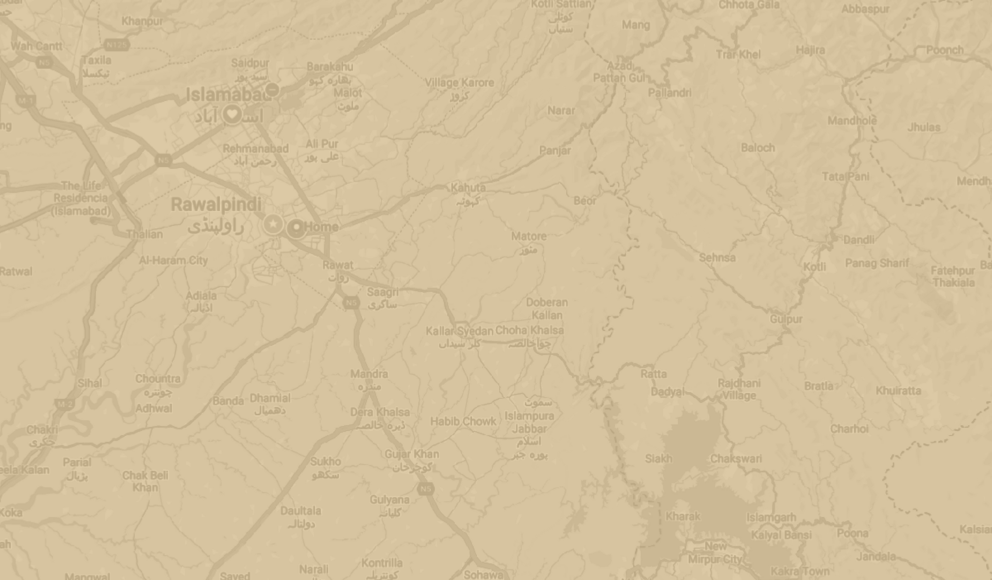








TEZ
Ibtehaj 22i-0767
Usman 22i-1177
Muaz 22i-1125

Slide 2

3 Layer Architecture Model Solution

Slide 3
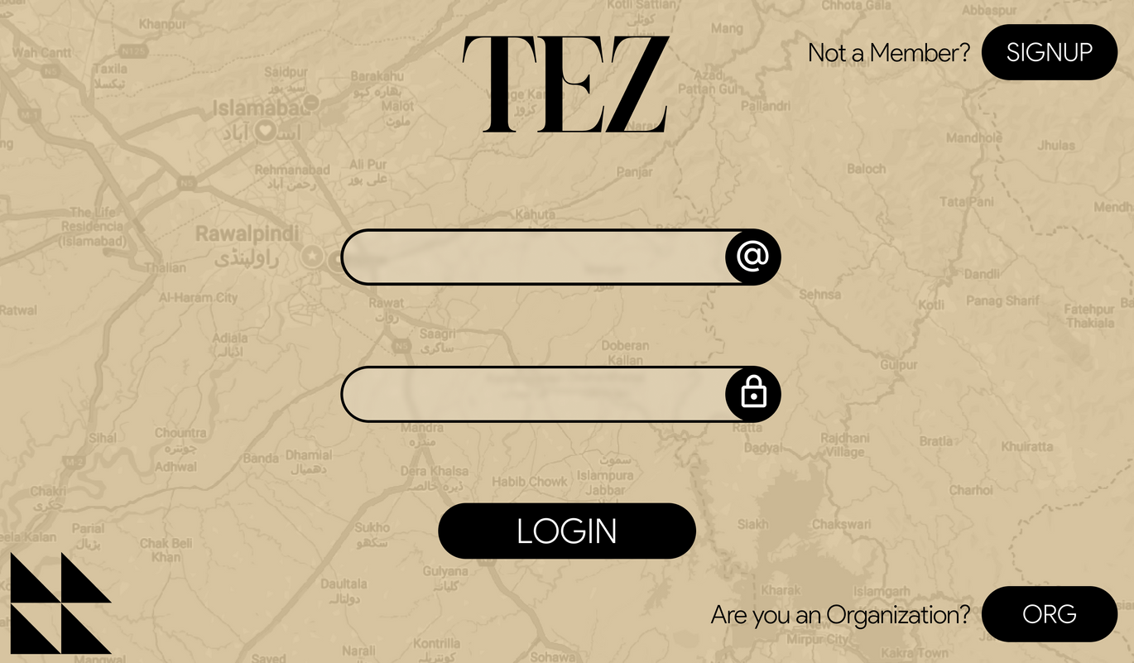
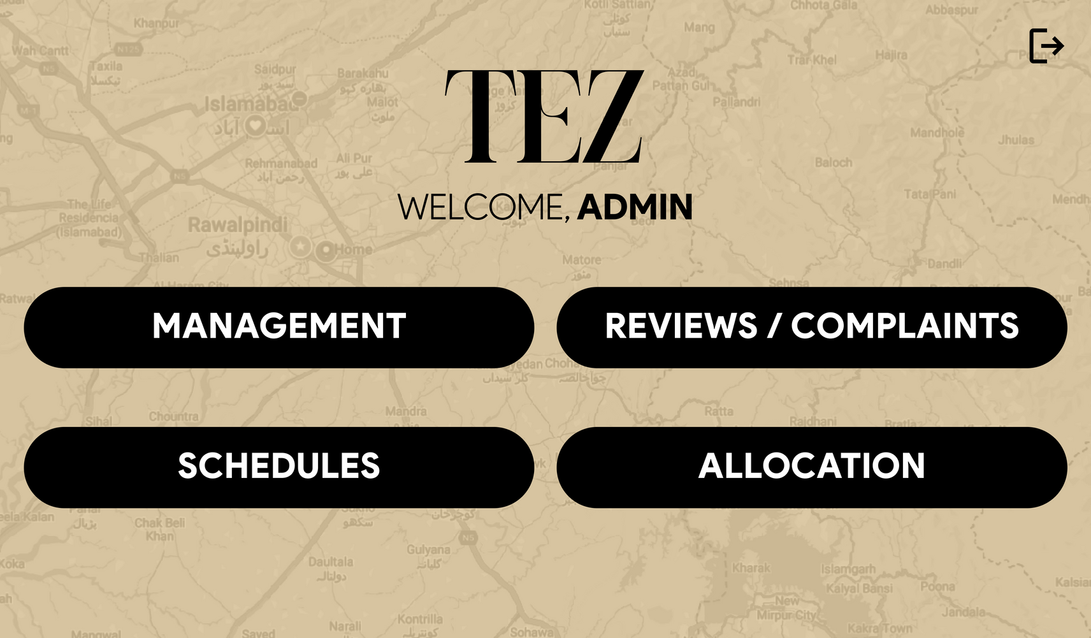
Java FX (UI)
Admin Page
Login Page

Slide 4
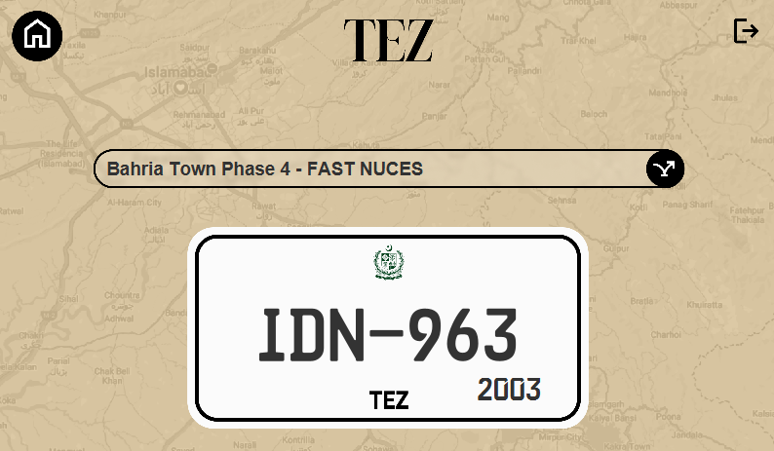
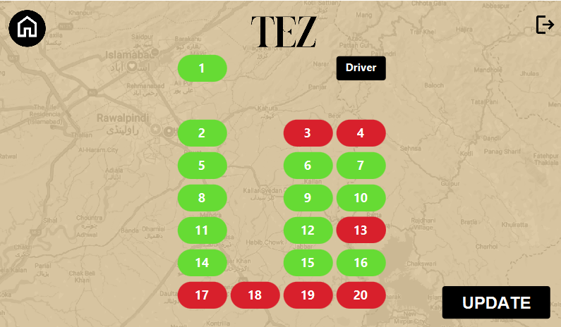
Driver update status
Driver Mode

Slide 5
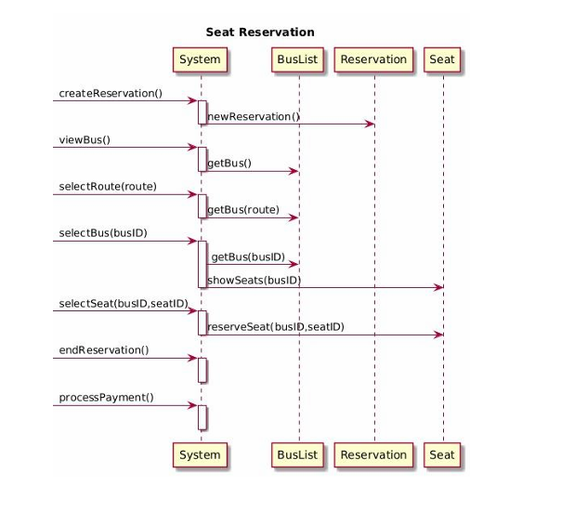
Complex Usecase & Diagrams

Slide 6
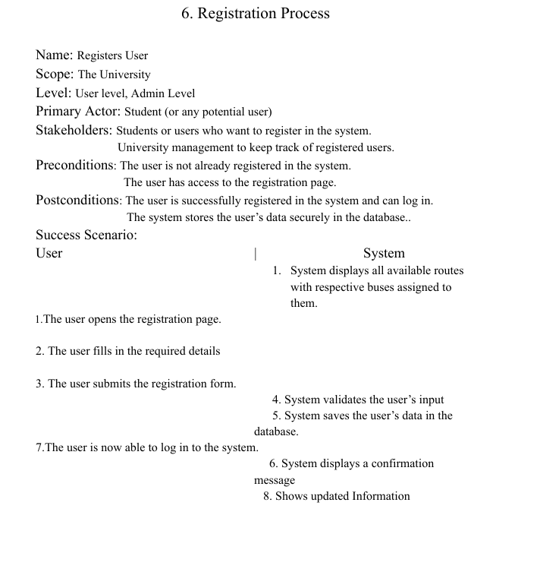
Seat Reservation

Slide 7
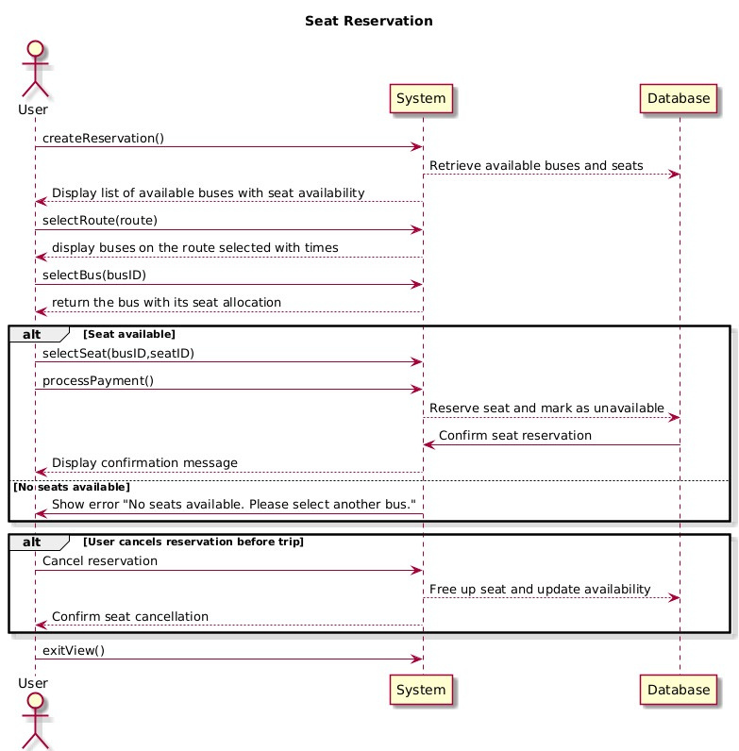
Sequence Diagram

Slide 8
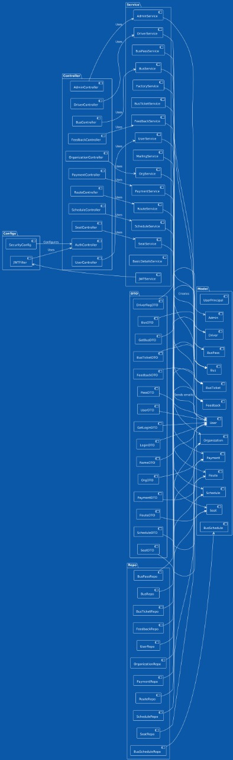
Package Diagram

Slide 9
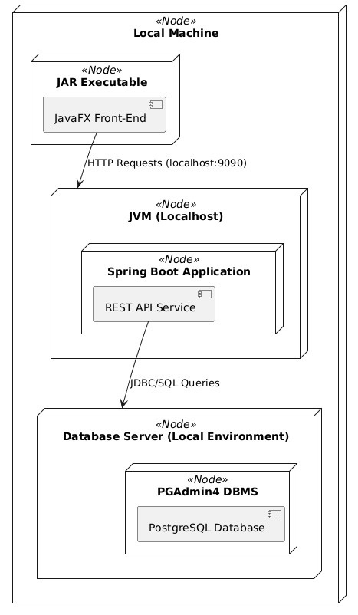
Deployment Diagram

Slide 10
Backend
DB Tools: SQL Server, PostGre
Connection:JDBC

Slide 11
GRASP SOLUTION
Controller
Information Expert
Creator
Low Coupling
High Cohesion

Slide 12

Design Patterns
Chain of responsibility
Factory pattern
Singleton
Adapter

Slide 13
Thank you very much!

